Slide 1

PJMW-219, HOURLY ENERGY CONSUMPTION
PROJECT -
GROUP - 03
MENTOR NAME: MADISHETTI RAJASHEKAR
GROUP MEMBERS -
DEEPESH, DEVA DHARSHINI, SUJAL,
SHIVA, VIVEK, SRAVYA.

Slide 2

BUSINESS OBJECTIVE :
ABOUT DATASET :-
PJM Interconnection LLC (PJM) is a regional transmission organization (RTO) in the United States. It is part of the Eastern Interconnection grid operating an electric transmission system serving all or parts of Delaware, Illinois, Indiana, Kentucky, Maryland, Michigan, New Jersey, North Carolina, Ohio, Pennsylvania, Tennessee, Virginia, West Virginia, and the District of Columbia. The hourly power consumption data comes from PJM's website and are in megawatts (MW).
PROBLEM STATEMENT :-
Split the last year into a test set- can you build a model to predict energy consumption.
Find trends in energy consumption around hours of the day, holidays, or long term trends.
Understand how daily trends change depending of the time of year. Summer trends are very different than winter trends.
Forecast for next 30 days.

Slide 3
PROJECT FLOW :
Understanding the problem statement
EDA (Exploratory Data Analysis)
→ Data Pre-processing
→ Data cleaning
→ Visualization
→ Weekday, holiday and seasonal Trend
→ Outlier Detection
→ Outlier Removal
3. Model Building
→ 5 Models
→ Choosing The Final Model
→ Forecast For Next 30 Days
Model Deployment

Slide 4
PHASE - 1
EXPLORATORY DATA ANALYSIS (EDA)

Slide 5
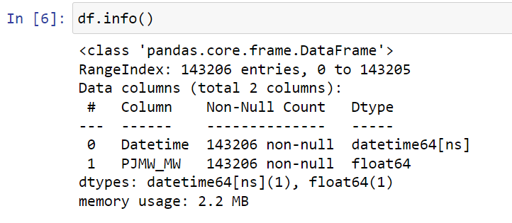
Data Information

Slide 6
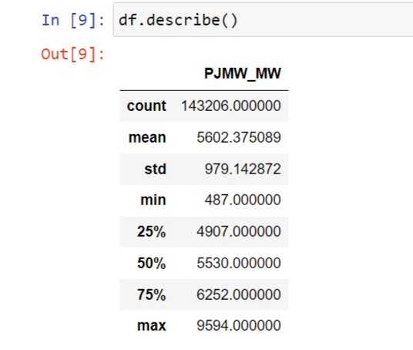
Data Description

Slide 7
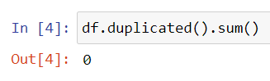
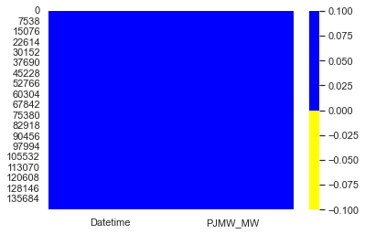
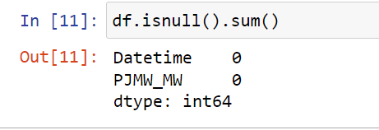
Checking for Null Values

Slide 8
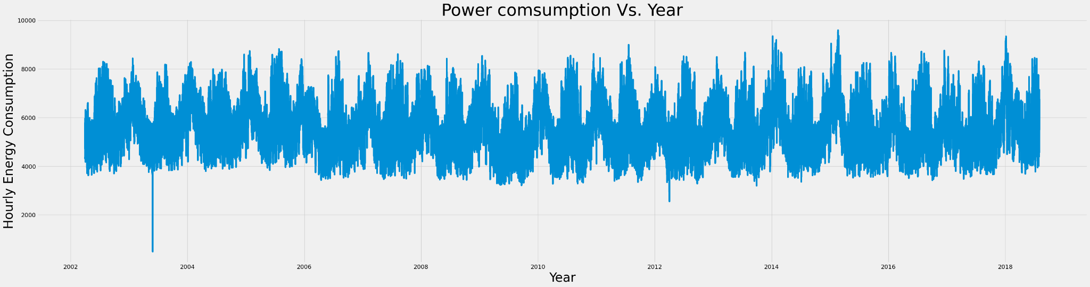
Plotting the data

Slide 9
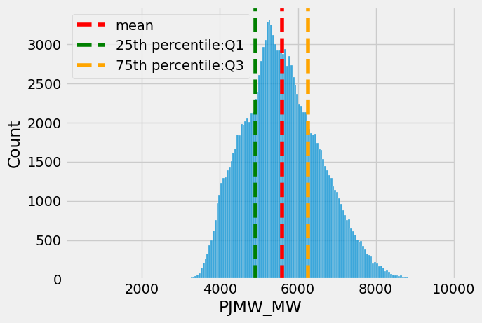
Histogram

Slide 10
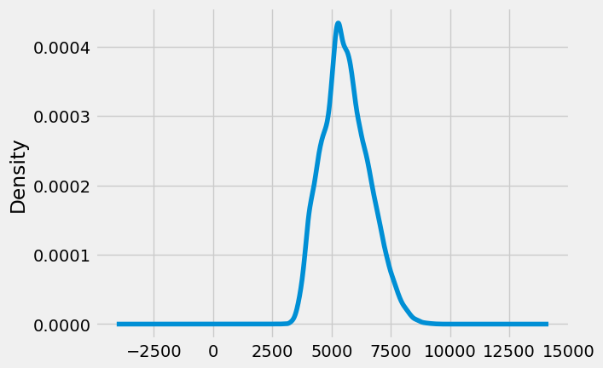
Density Plot

Slide 11
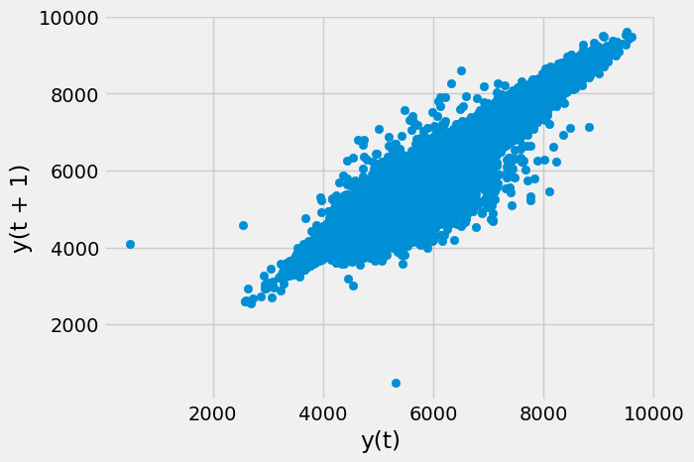
Lag Plot

Slide 12
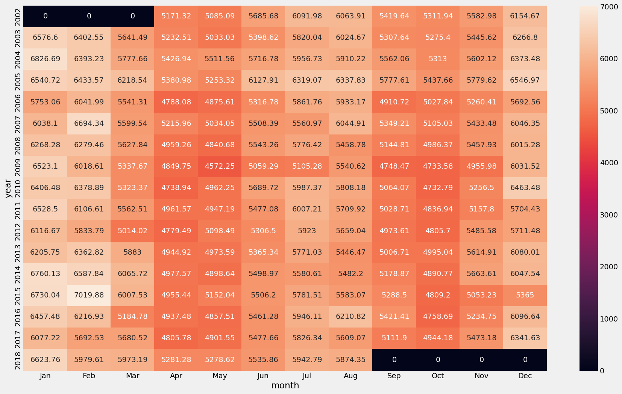
Heatmap

Slide 13
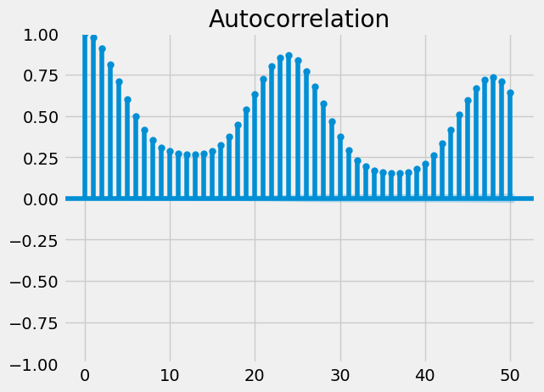
ACF Plot

Slide 14
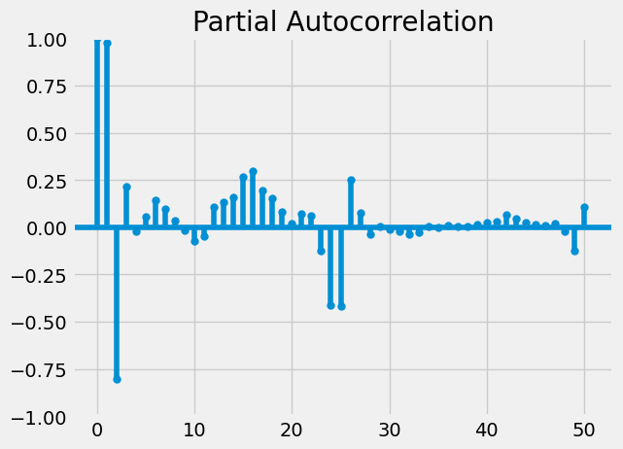
PACF Plot

Slide 15
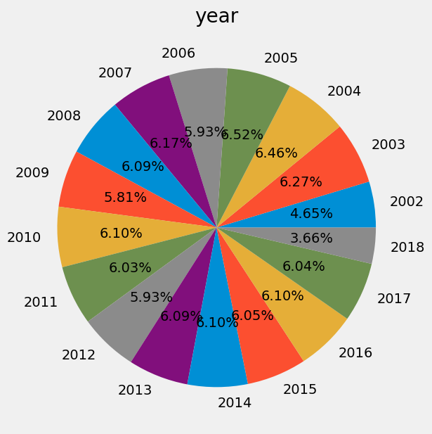
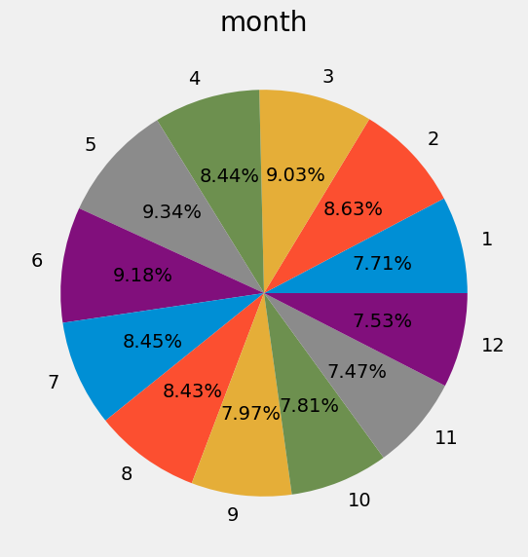
Pie Chart

Slide 16
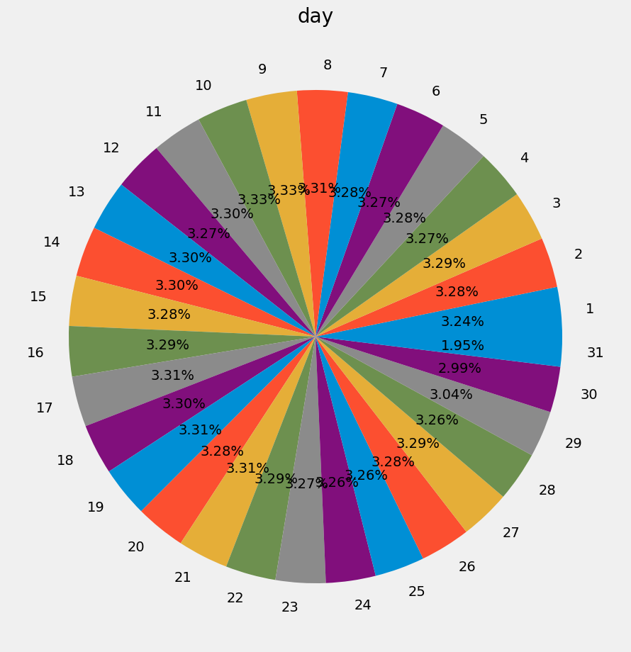
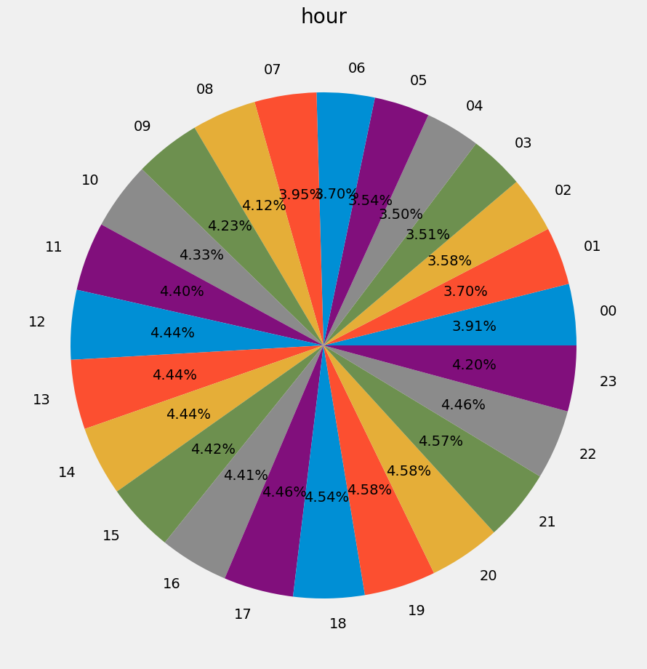
Pie Chart

Slide 17
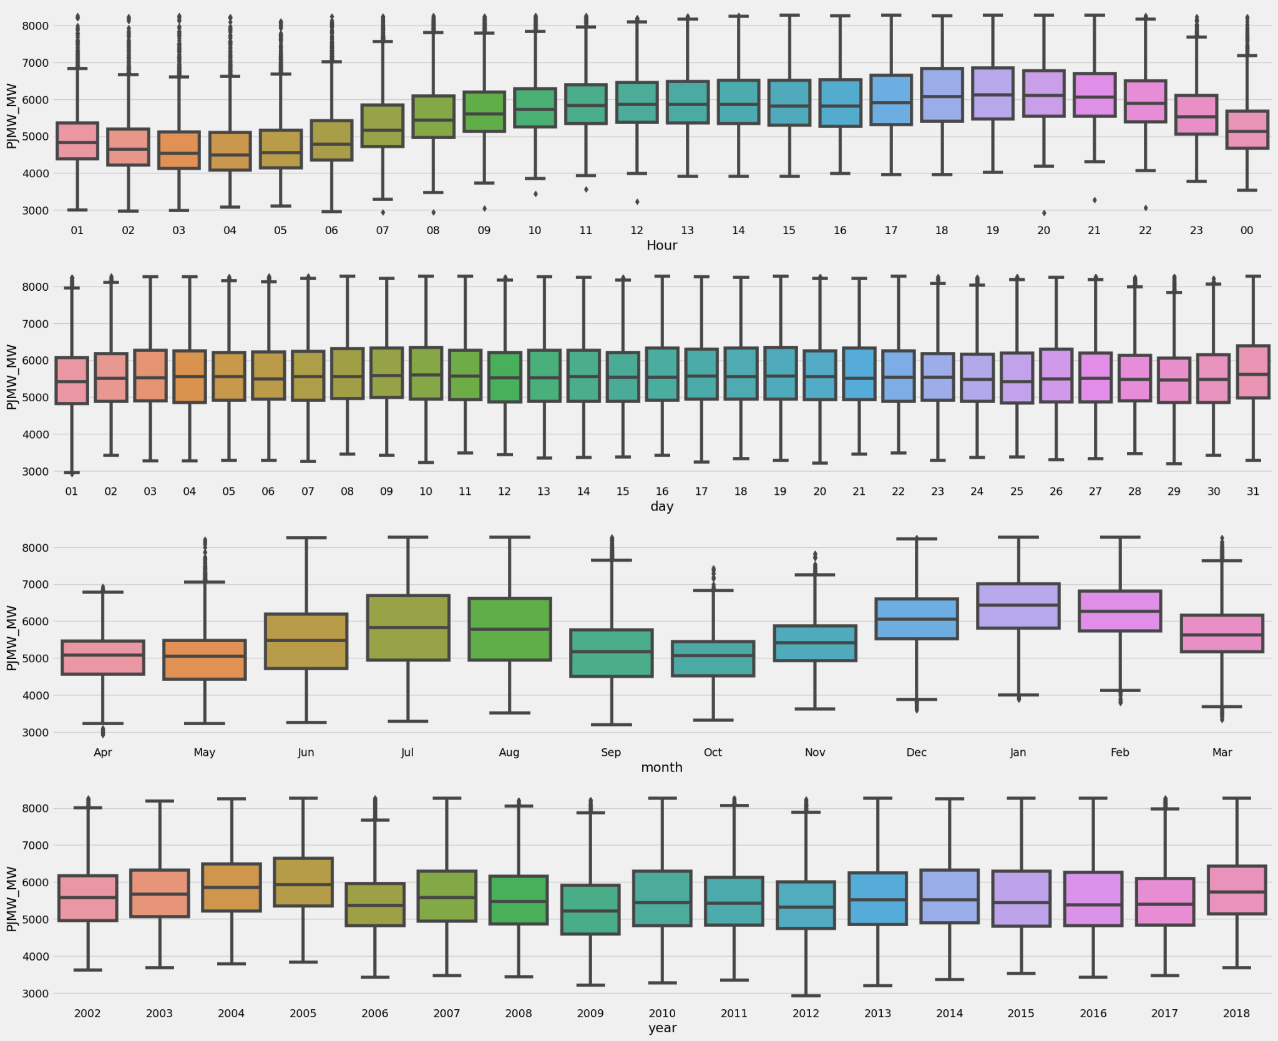
Box Plot

Slide 18
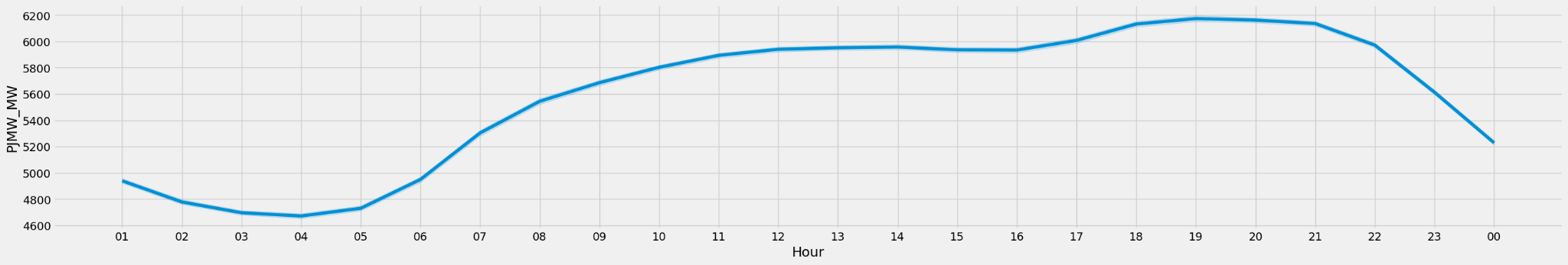
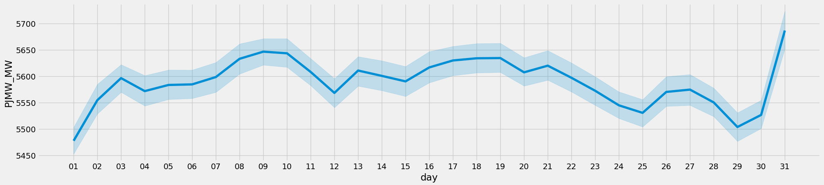
Line Plot

Slide 19
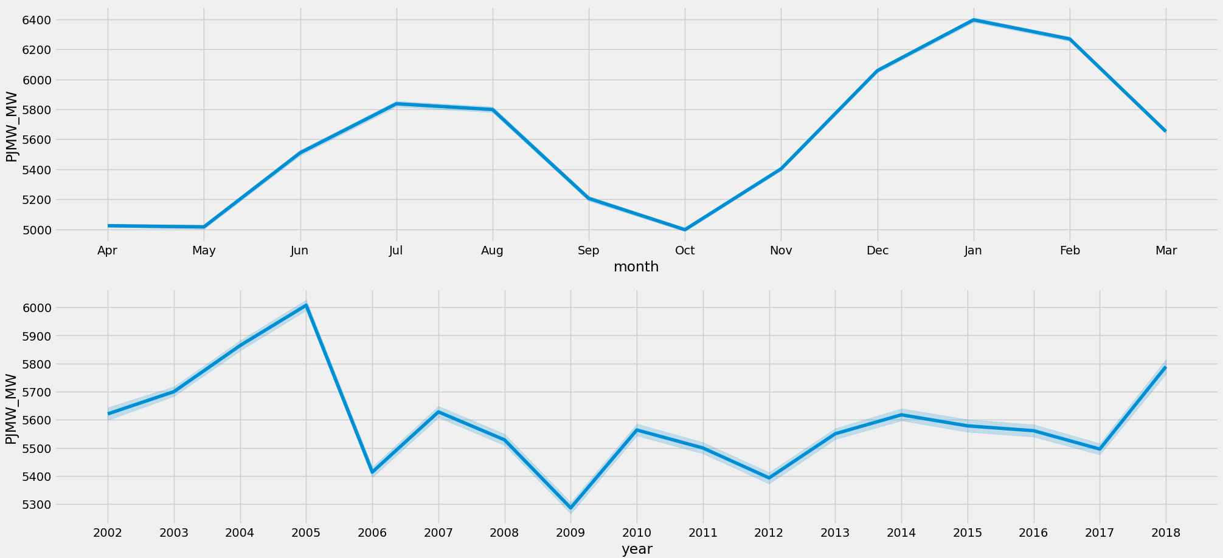
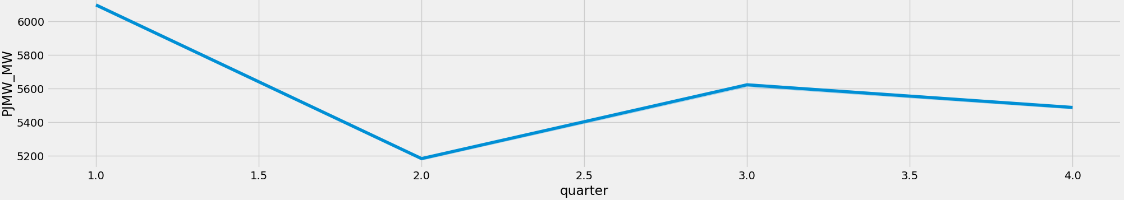

Slide 20
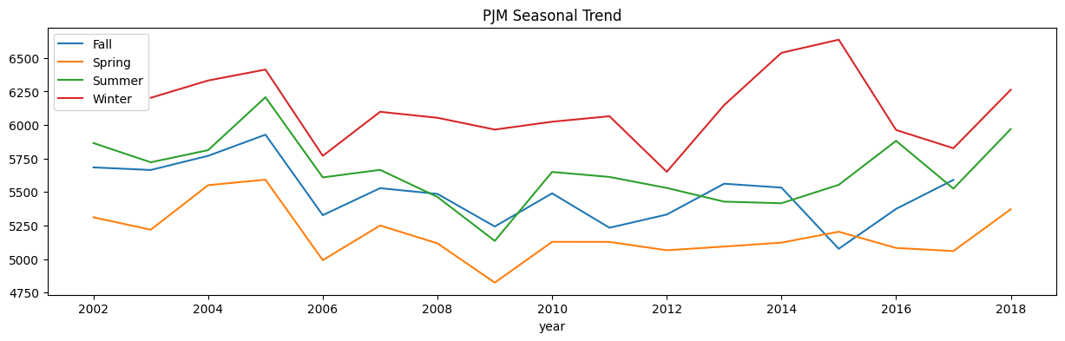
Seasonal Plot

Slide 21
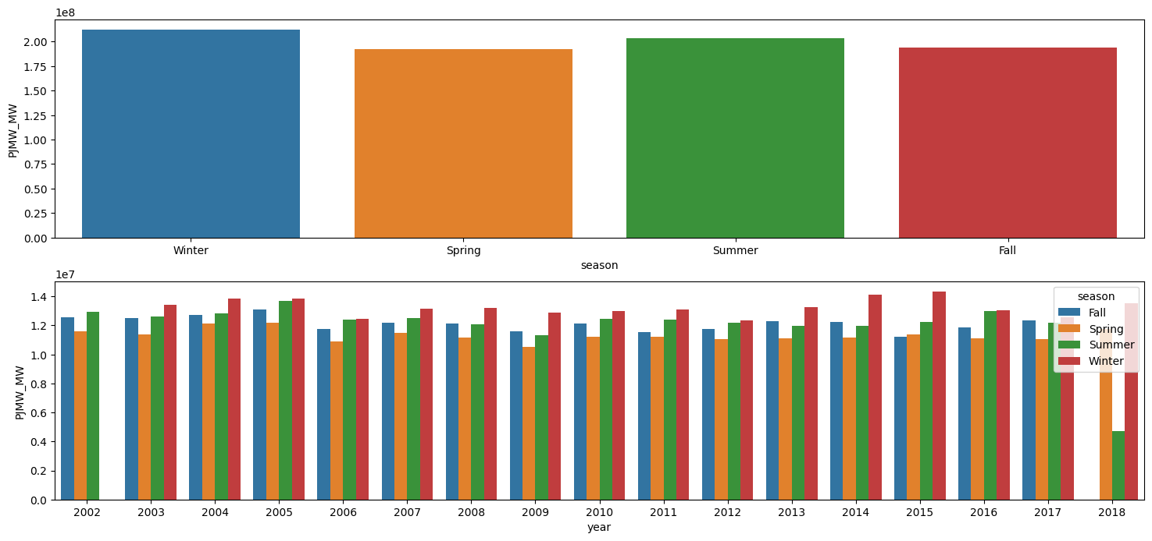
Seasonal Trend

Slide 22
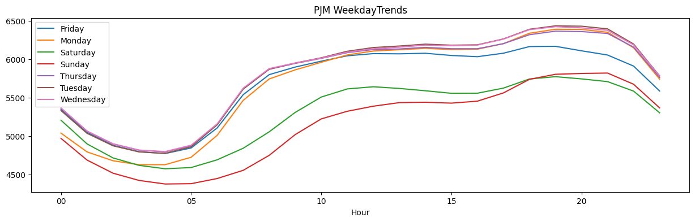
Weekday Trends

Slide 23
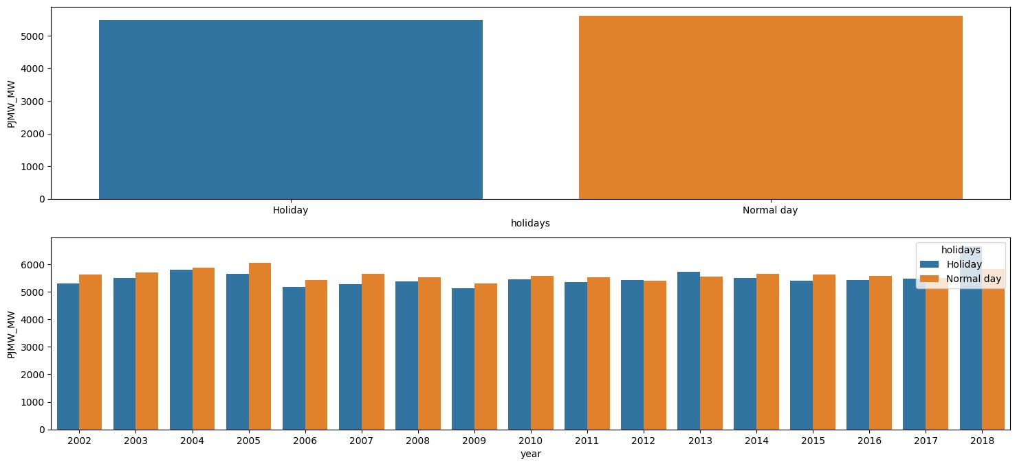
Trend Of Energy Consumption During Holidays

Slide 24
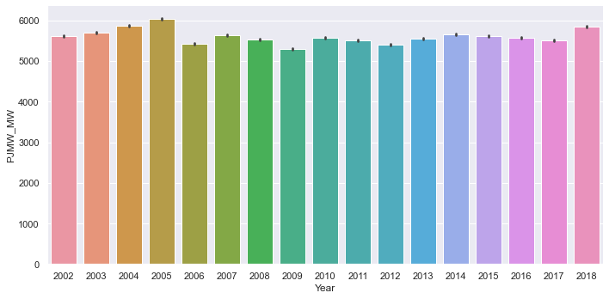
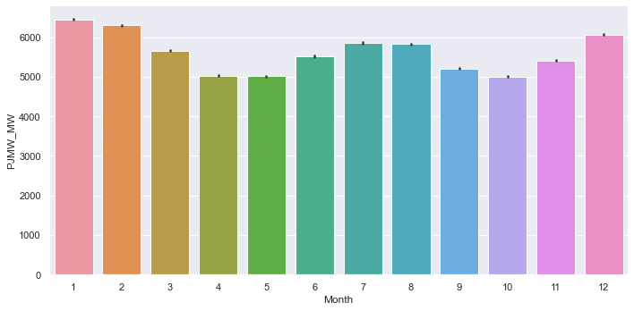
Cat Plots

Slide 25
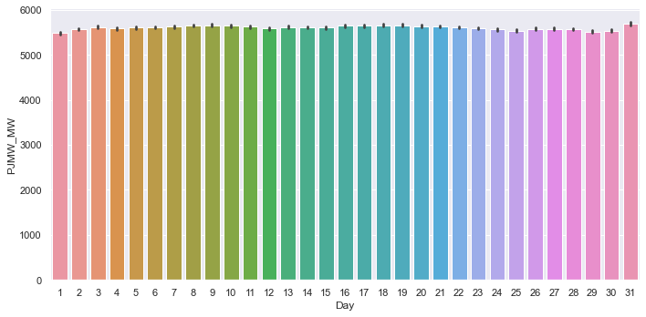
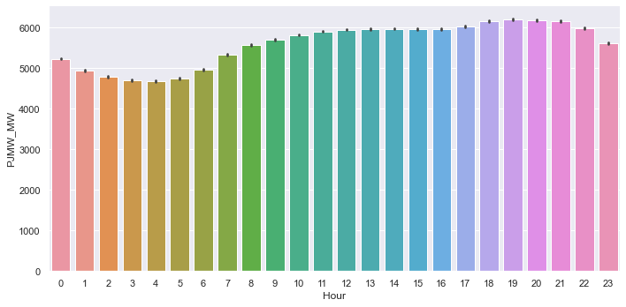

Slide 26
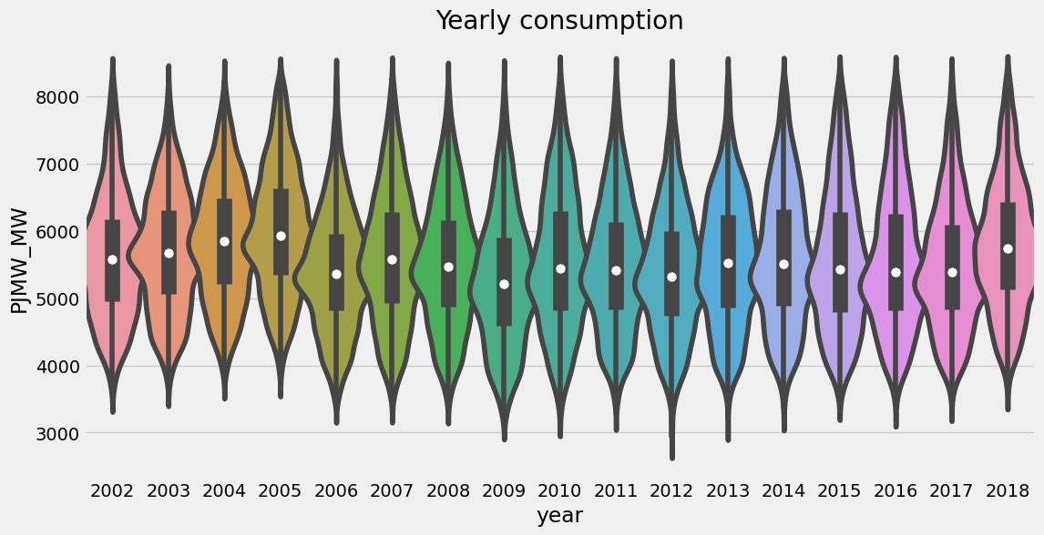
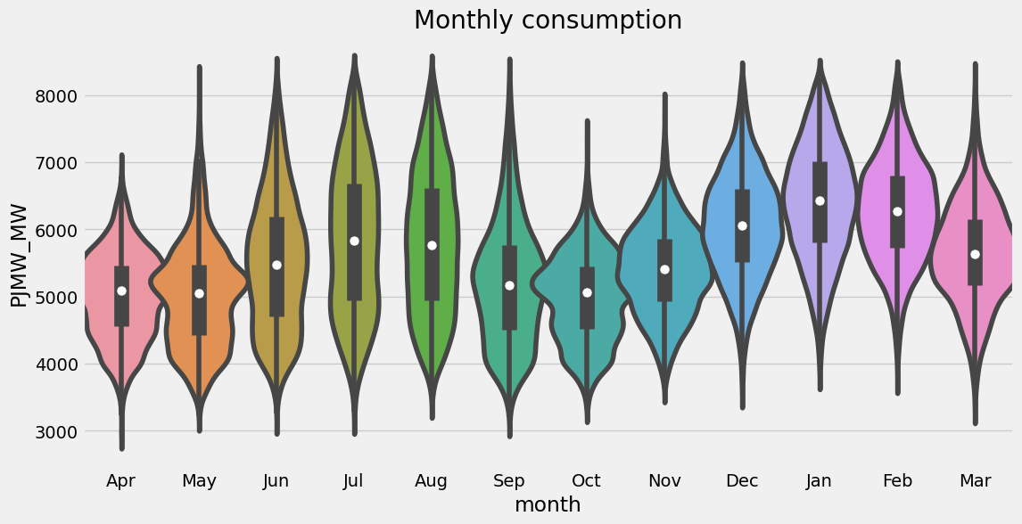
Violin Plot

Slide 27
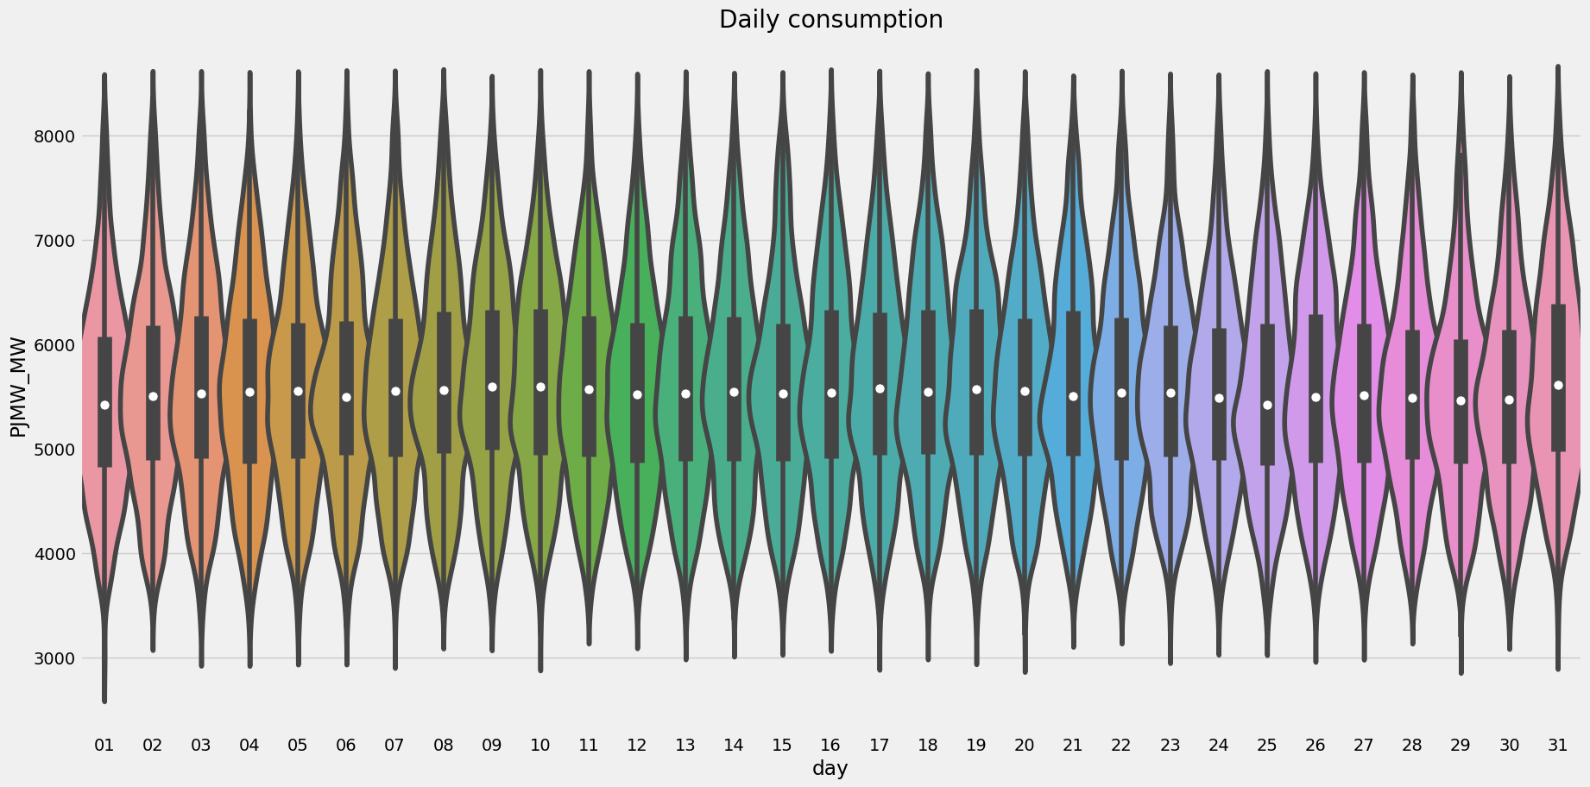
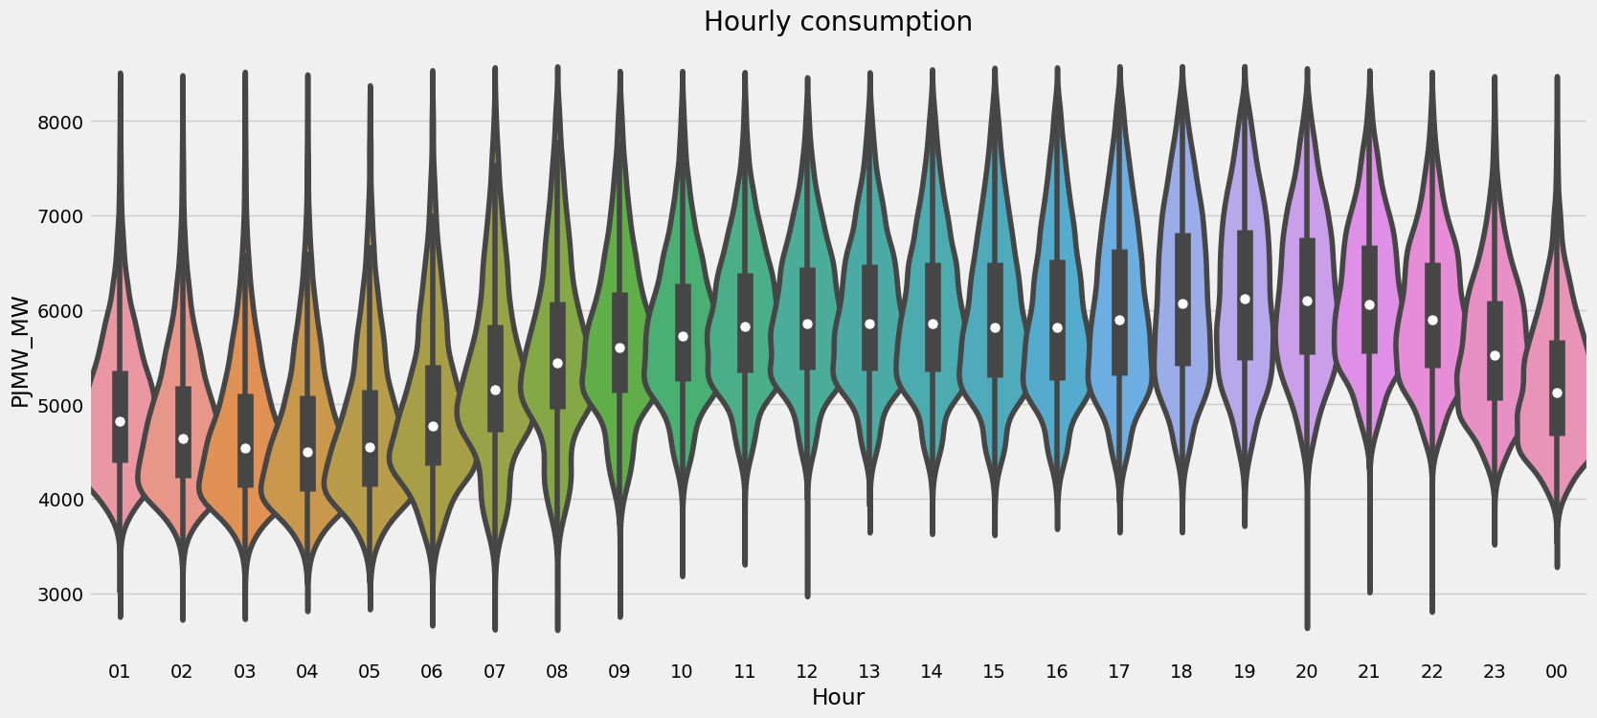

Slide 28
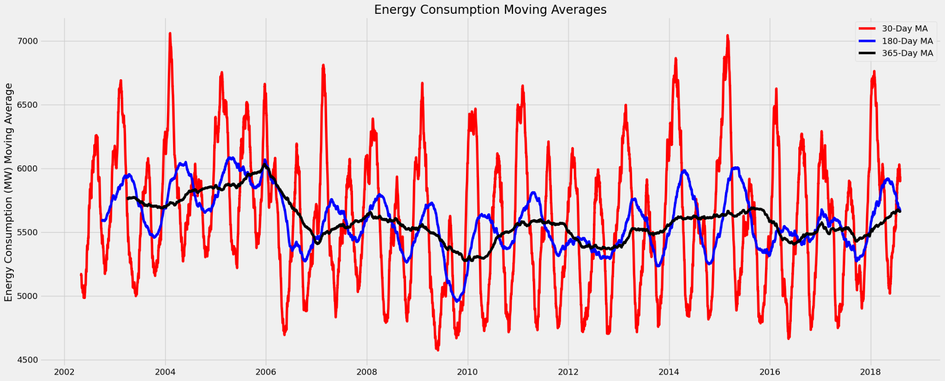
Moving Average

Slide 29
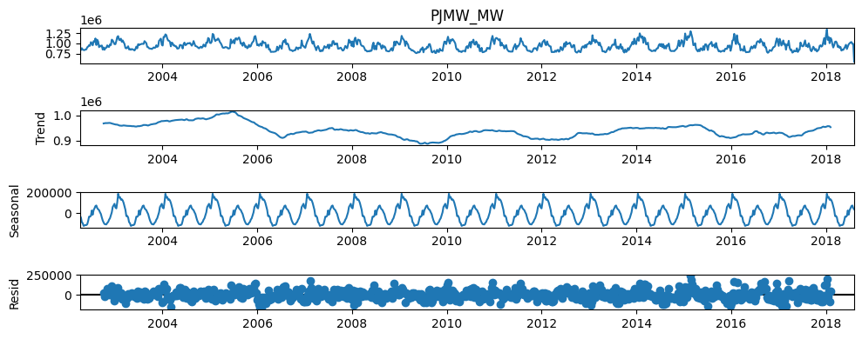
Time Series Decomposition

Slide 30
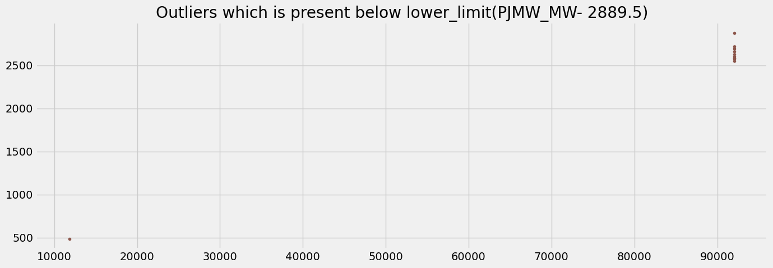
Outlier Detection

Slide 31
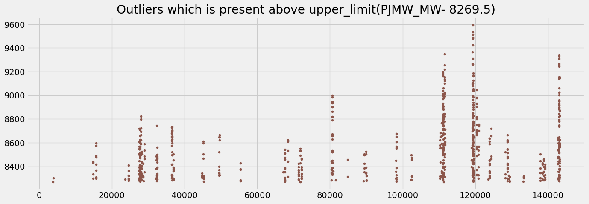

Slide 32
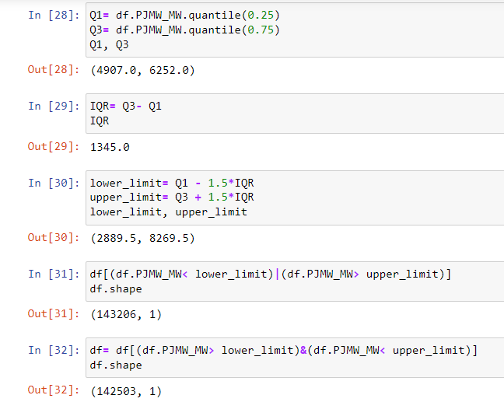
Outlier
Removal

Slide 33
PHASE - 2
MODEL BUILDING

Slide 34
MODELS BUILT:
:
1. PROPHET MODEL
2. DEEP NEURAL NETWORK
3. XGBOOST
4. LINEAR REGRESSION
5. RANDOM FOREST

Slide 35
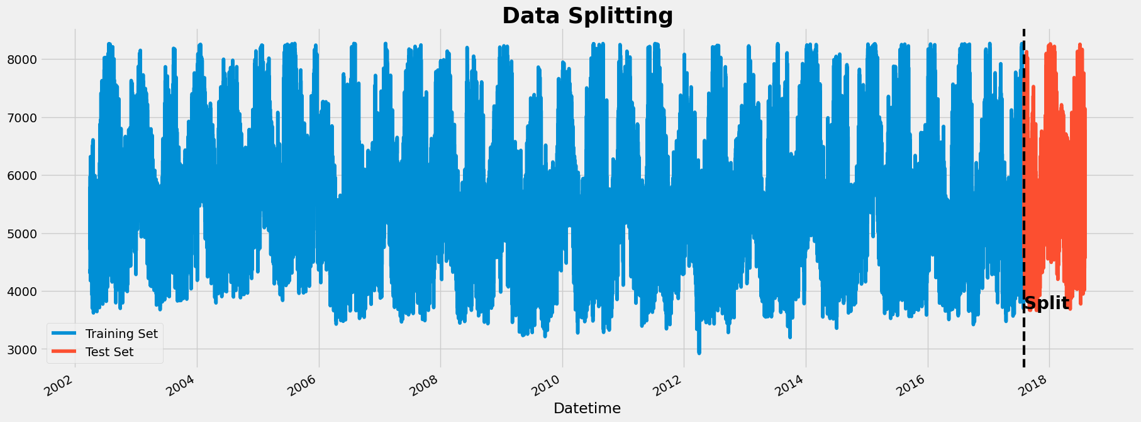
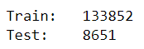
Splitting the data set

Slide 36
PROPHET MODEL
Prophet is an open-source library for univariate (one variable) time series forecasting developed by Facebook. It works best with time series that have strong seasonal effects and several seasons of historical data.

Slide 37
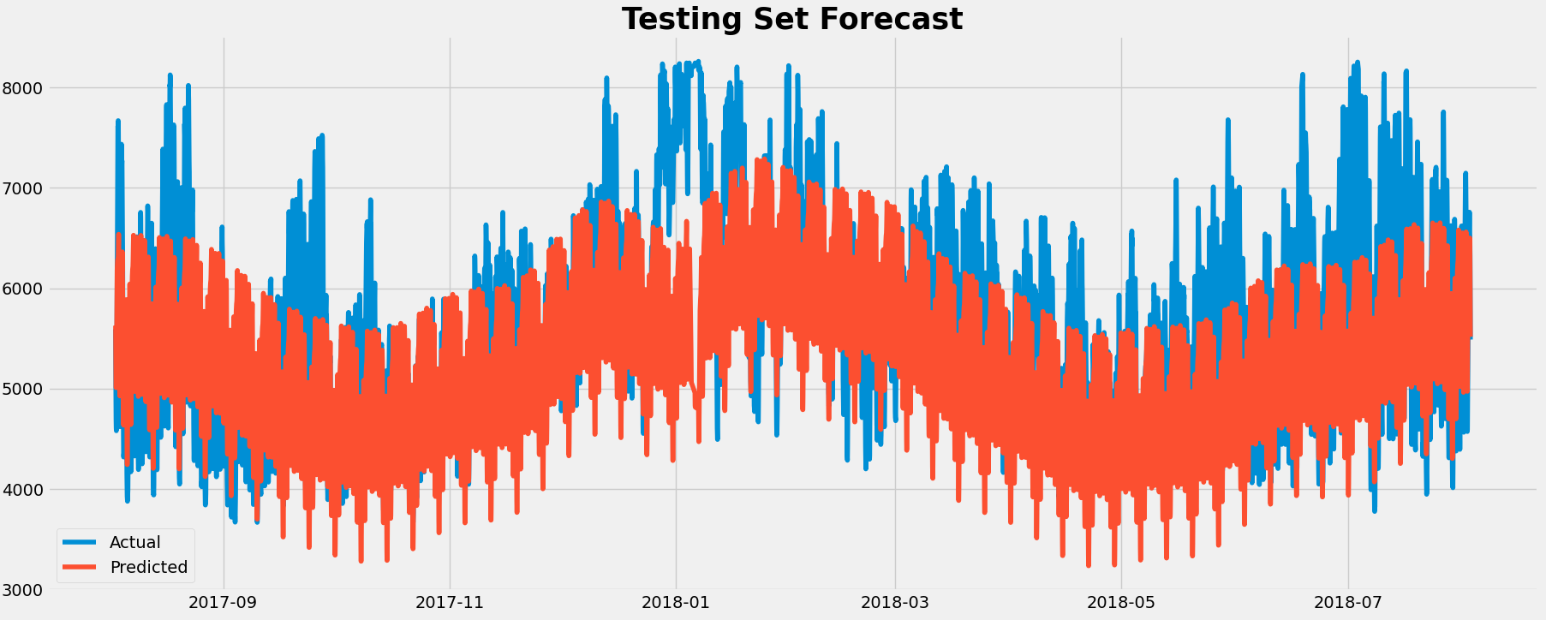
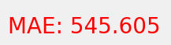
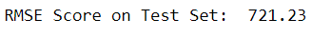

Slide 38
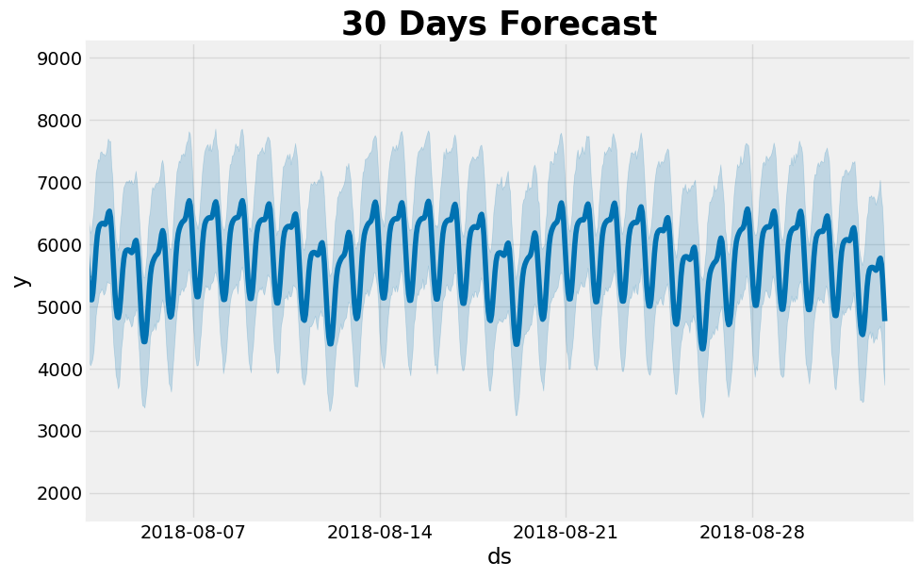

Slide 39
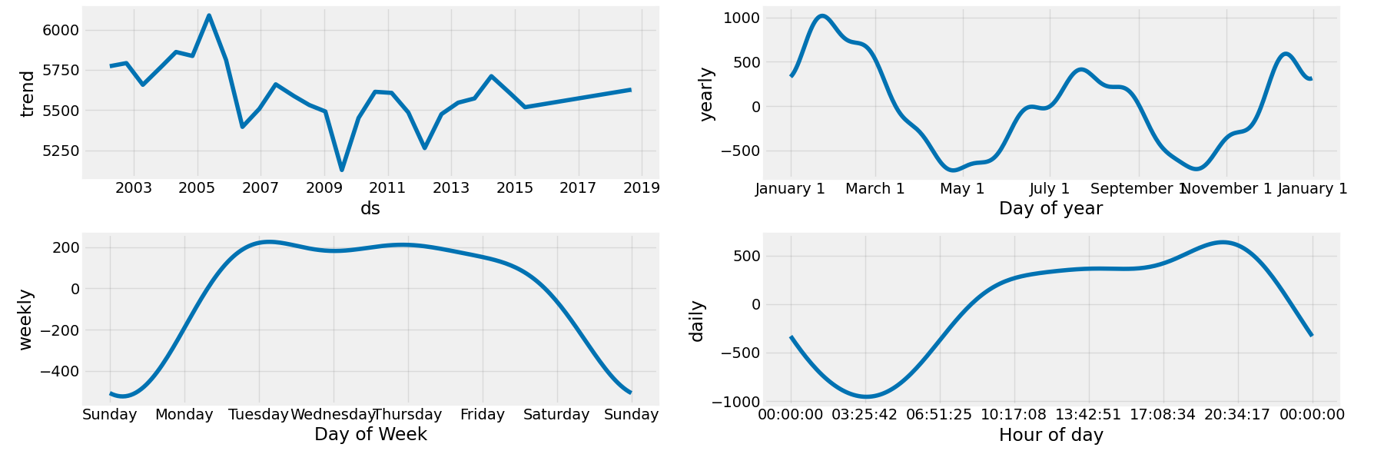

Slide 40
2. DEEP NEURAL NETWORK
The Deep Learning framework we are using is Tensorflow. Before feeding the data into Neural Network, we have to do some modification to the data so they can be accepted by the model.
We are going to use windowing technique which basically group the data into feature and label. The label will be the next value. You can take a look at the next few cells to give an idea what we are going to do

Slide 41
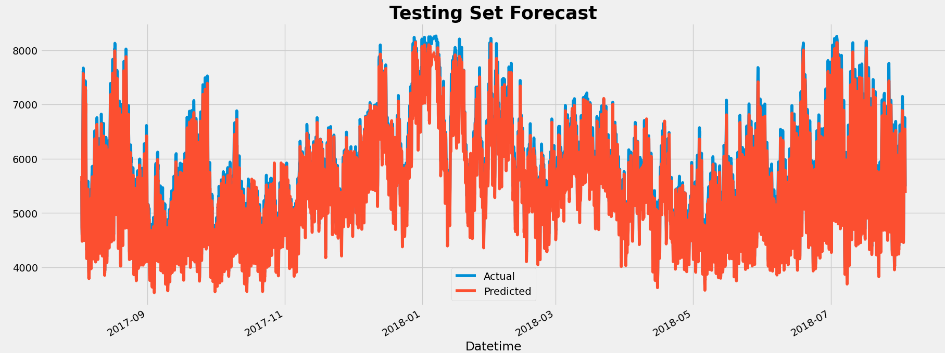
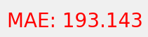

Slide 42
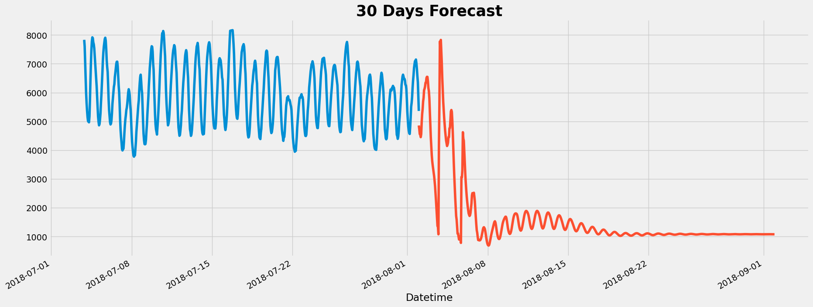
The Forecast of Deep Neural Network(DNN) model is not satisfactory.

Slide 43
3. XGBOOST MODEL
XGBoost is short for Extreme Gradient Boosting and is an efficient implementation of the stochastic gradient boosting machine learning algorithm. The stochastic gradient boosting algorithm, also called gradient boosting machines or tree boosting, is a powerful machine learning technique that performs well or even best on a wide range of challenging machine learning problems.
To be able to use XGBoost for time series forecasting, the data should be transformed into supervised learning before feeding it into the model.

Slide 44
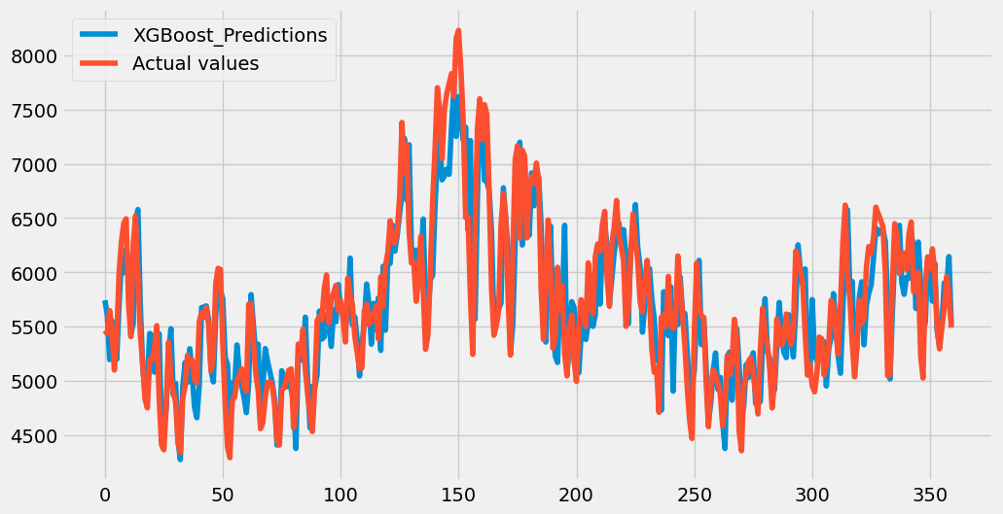
Prediction has been done with test data

Slide 45
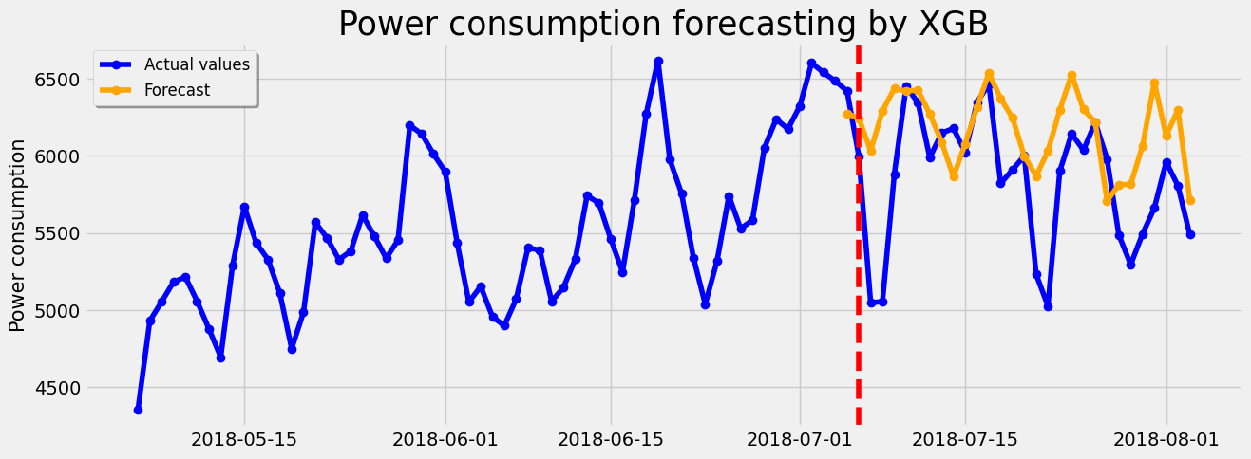
Forecasting

Slide 46


Predicted RMSE,MAE,MAPE
Forecasted RMSE,MAE,MAPE

Slide 47
4. LINEAR REGRESSION
Linear regression is a quiet and the simplest statistical regression method used for predictive analysis in machine learning. Linear regression shows the linear relationship between the independent(predictor) variable i.e. X-axis and the dependent(output) variable i.e. Y-axis, called linear regression. If there is a single input variable X(independent variable), such linear regression is called simple linear regression.

Slide 48

Prediction has been done with test data

Slide 49

Forecasting

Slide 50


Predicted RMSE,MAE,MAPE
Forecasted RMSE,MAE,MAPE

Slide 51
5. RANDOM FOREST
Random forest is a Supervised Machine Learning Algorithm that is used widely in Classification and Regression problems. It builds decision trees on different samples and takes their majority vote for classification and average in case of regression. One of the most important features of the Random Forest Algorithm is that it can handle the data set containing continuous variables, as in the case of regression, and categorical variables, as in the case of classification. It performs better for classification and regression tasks.

Slide 52

Prediction has been done with test data

Slide 53

Forecasting

Slide 54


Predicted RMSE,MAE,MAPE
Forecasted RMSE,MAE,MAPE

Slide 55

Findings
Based on our finding, we can see RANDOM FOREST model has less errors (RMSE, MAE, MAPE).
So forecasted power consumption for next 30 days from 2018-08-03 using RANDOM FOREST.

Slide 56

Forecasting for next 30 days

Slide 57
PHASE - 3
MODEL DEPLOYMENT

Slide 58

DEPLOYED MODEL :
:
The model is deployed on Streamlit framework and the Integrated Development Environment (IDE) used for its development was Spider.

Slide 59
CHALLENGES FACED:
:
The team faced various errors related to dependencies, libraries, and compatibility issues, which hindered the smooth deployment of the model.
In the DNN model, we were unable to perform forecasting correctly, and calculation time was considerably longer.
We encountered a wide variety of issues in the Spyder console throughout the deployment when we were building the site for our model.
These errors may have resulted from differences in the development and production environments, variations in package versions, or conflicts between dependencies.

Slide 60


